Slide 1
MASTERMIND
Interactive GUI + Guess-Checking Function
Mark Zebian Pranav Bejugama Vishal Kathirasan Kannan Ashwin Ramanan

Slide 2
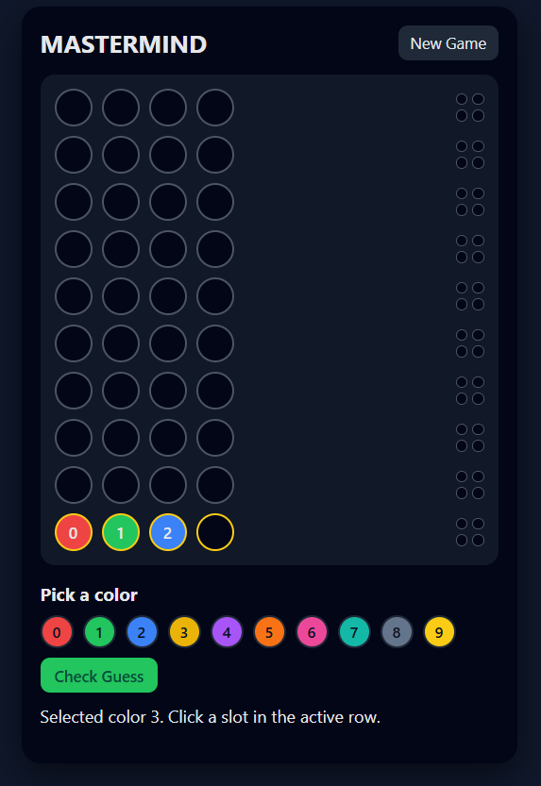
Overview of Our Project
Web-based version of Mastermind
Uses HTML, CSS, JavaScript
Fully interactive GUI
Implements the required guess_score logic
Allows players to try 10 guesses to crack a 4-digit code
Includes accessibility & UI features like color palette + clear feedback

Slide 3
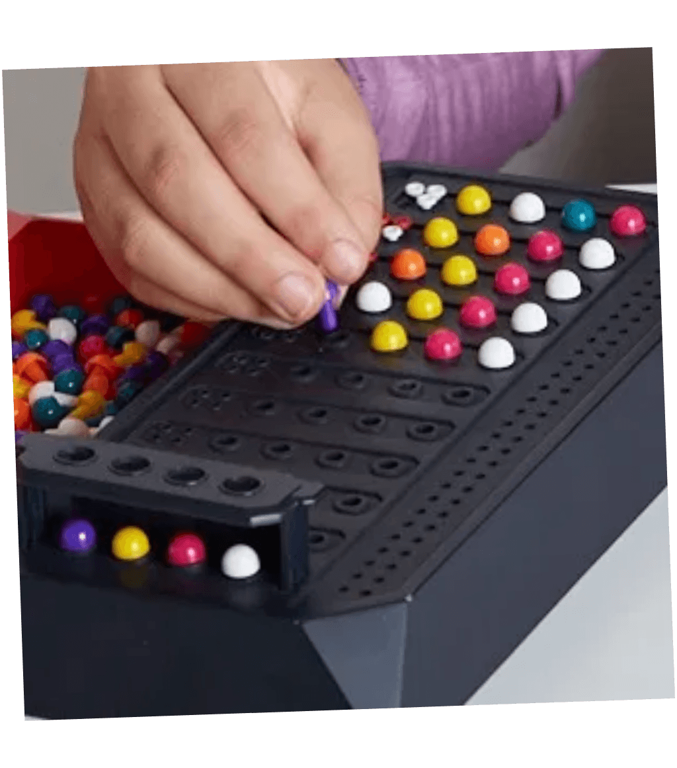
What is Mastermind
Mastermind = code-breaking logic game
Goal: guess a 4-digit secret code
Each digit = number 0-9
You have 10 attempts
After each guess, game gives:
Black peg → correct number & correct position
White peg → correct number but wrong position

Slide 4
Requirements
Create a function that compares the secret code & guess
Return the number of black & white pegs
Build a front-end GUI that is functional and visually appealing
Provide feedback after each guess
Make the game playable for the user

Slide 5
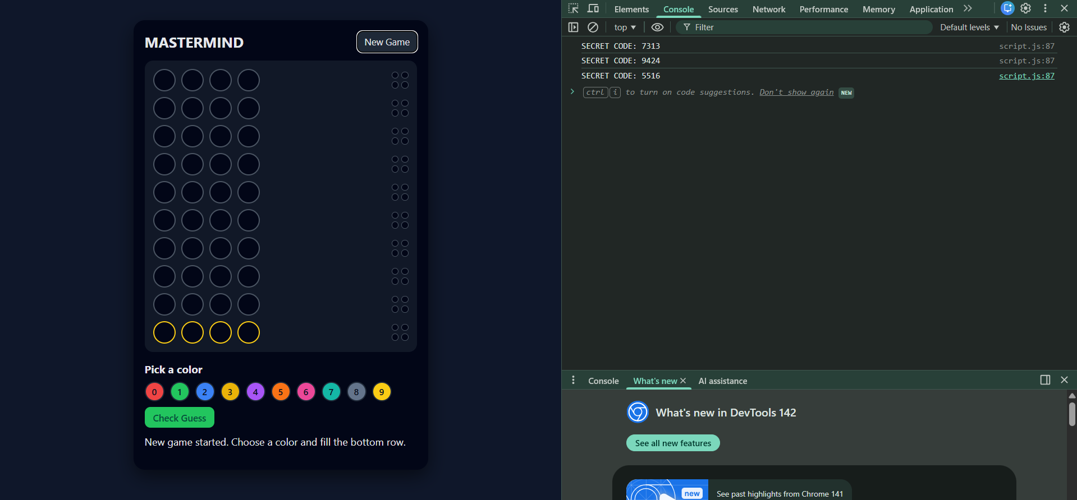
Our System Overview (Architecture)
Front-End (HTML + CSS) builds the layout and design
JavaScript drives all game logic
Console code generation (developers to check)
Input handling and row control
Peg feedback system
New Game resets the entire board

Slide 6
Front-End Design (HTML Structure)
• Clean, organized layout
• 10 dynamic rows for guesses
• Each row: 4 guess slots + 4 feedback pegs
• Number palette (0–9)
• “New Game” and “Check Guess” buttons
• Status message guiding the user

Slide 7
Visual Layout
• Dark theme with high-contrast colors
• Rows arrange bottom-up (latest guess at bottom)
• Active row visually highlighted
• Rounded elements for a more polished look
• Simple, minimal, easy-to-understand interface

Slide 8
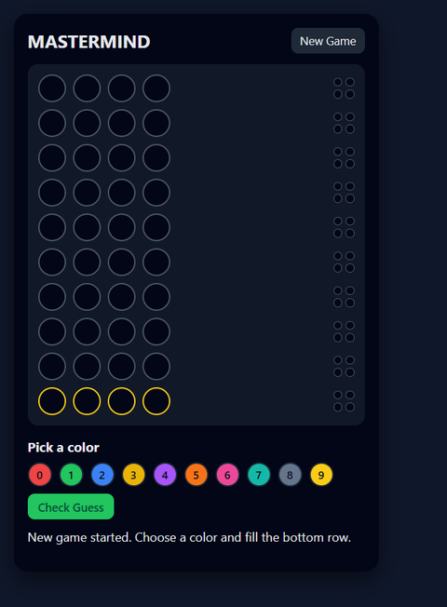
CSS Design Choices
• Dark theme reduces eye strain
• Colorful palette buttons
• Subtle highlights for the active row
• Rounded buttons and circles
• Consistent spacing and alignment
• The modern UI that feels very elite

Slide 9
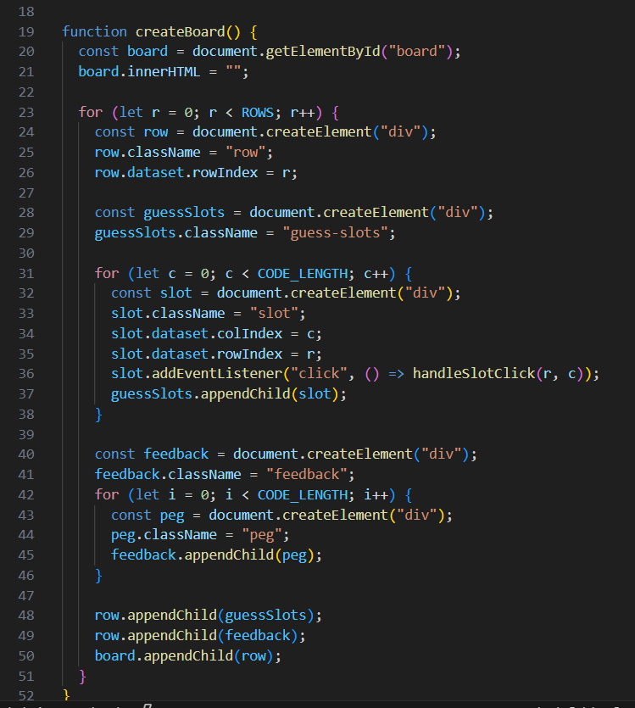
Game Logic (JavaScript Overview)
JS creates board dynamically
Handles click events on slots
Tracks:
  Current row
  Selected color
  Secret code
  Game state
Updates feedback after each guess
Resets board on new game

Slide 10
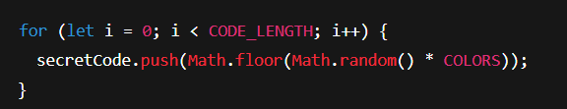
Secret Code Generation
Each digit: random 0–9
Stored in a hidden array
Only revealed at the end if the player loses

Slide 11
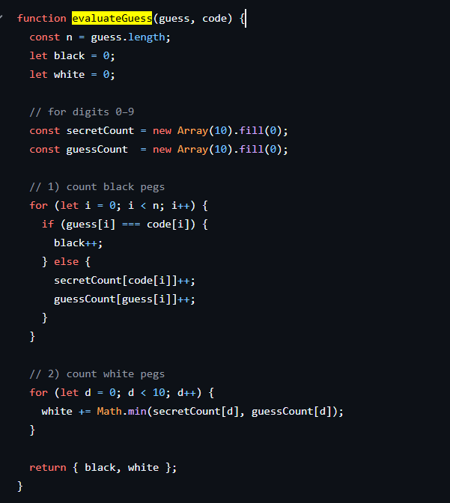
Core Function — evaluateGuess()
Matches competition rules
Same logic as official Mastermind scoring
Avoids double counting
Works even with repeated numbers

Slide 12
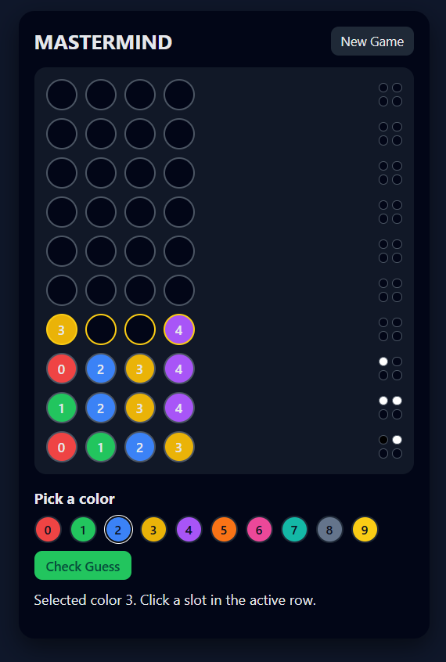
User Interaction Flow
User selects a color
Clicks a slot → slot fills
After 4 slots are filled → press Check Guess
System evaluates guess
Feedback pegs appear
Move to next row
Ends when:
  All 4 black pegs → win
  10 rows used → lose

Slide 13
Accessibility & Extra Features
01
03
02
05
04
Color selection uses numbers for color-blind accessibility
Dark mode reduces eye strain
Clear button labels: “New Game”, “Check Guess”
Repeatable & consistent layout
Status messages guide the user

Slide 14
Challenges We Faced
Making the board dynamic instead of hard-coded
Preventing double-counting in scoring
Handling repeated digits properly
Highlighting active row
Making UI responsive & clear
Keeping the game fun & intuitive

Slide 15
GITHUB
https://github.com/MarkZebian/Internal-Engineering-Competition/

Slide 16
THANKS!
Hope You Enjoy This Game.

